Slide 1




Slide 2
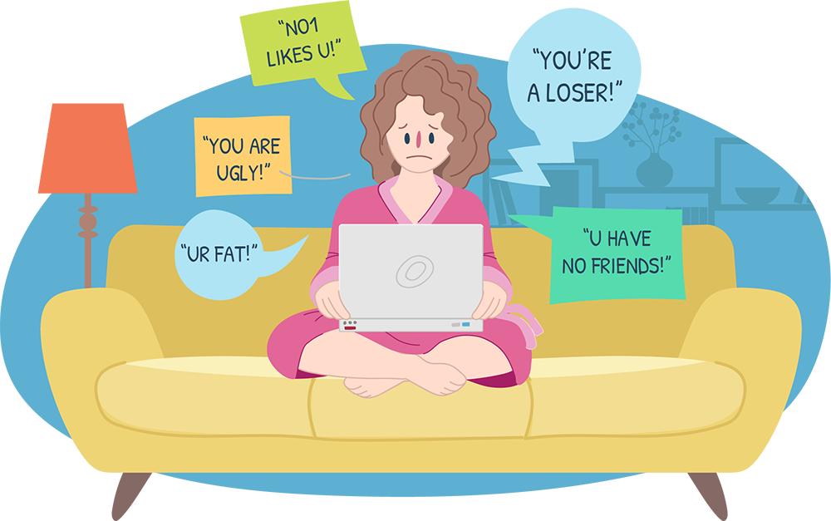
Cyber bullying
Cyber-Bullying is fast becoming the most common form of bullying in schools. With the increasing use of technology, children are using this as a way to bully and harass others.

Slide 3
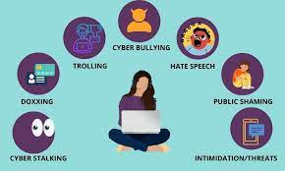
What is cyber bullying
repeated aggression
verbal aggression
psychological aggression
physical conduct by an individual or group against others
using Internet mobile phone or other technological devices
sustained or repeated behavior overtime which has a serious negative effect on the well being of the victim

Slide 4
What is cyber bullying?
Sending nasty, mean, threatening, embarrassing messages, phone calls, emails, photos, video clips
Silent phone calls
Nasty posts or pictures on a message board
Website chat room
Pretending to be someone else in text messages, chat rooms, message boards
Text messages saying hurtful things
Accessing someone else’s account to make trouble for them

Slide 5
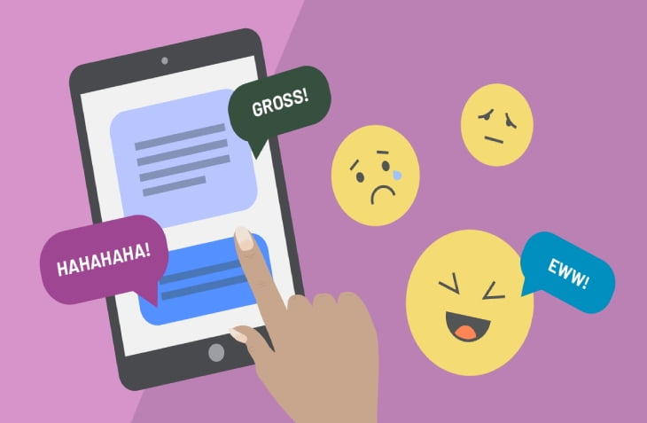
Different ways technology can be used to cyberbully
Instant messaging - live communication, chatrooms, emails, phone calls via the Internet
Email - electronic mail, Internet
Picture and video messaging - via mobile phones, forward photos like text messages
Texting - short messaging service (SMS)
Social networking sites - help connect friends using blogs, profiles, Internet email system, photos ( Facebook, Myspace, Twitter, Nimble.

Slide 6
Different ways technology can be used to cyberbully
Chat rooms- chat room forums via internet. Conversations are called threads.
Game consoles– sony playstation, Nintendo wii, xbox playing games with another individual via internet.
Online games- users play games through internet
Weblogs- blogs are intended for a public audience. It allows interaction with its readers through comments made on thread. Postings can be theme-related: anyone with internet can upload a comment.

Slide 7

Different ways technology can be used to cyberbully
Personal intimidation
Sending a threatening text message,
Making a threatening phone call
Posting abusive or threatening comments on victim’s profile
Creating a blog on a website allows visitors to make comments about victim
Instant messaging

Slide 8
Different ways technology can be used to cyberbully
Impersonation
- Fake profiles and web pages about victim – gaining access to someones profile or instant message account and using it to contact others and subsequently bully while impersonating the account or profile owner
Exclusion
- Blocking an individual from a popular group or community such as a school or class group on Facebook, Myspace.

Slide 9


Different ways technology can be used to cyberbully
Personal humiliation
- Posting images videos intended to embarrass or humiliate
- Sharing and posting images or videos of the victim being abused or humiliated offline
- Text messages or emails
False reporting
- Making false reports to service provider or reporting other users for a range of behavior with a view to having the user’s account or website deleted.

Slide 10

What do you need to know about cyber bullying
Anonymous nature /false identities
Security issues- personal information
Wrongly believing that online action doesn’t reflect real life
Messages remain available on the internet
Happens outside school via mobile phones, school and home computers
Being fearful of telling others for fear of being bullied

Slide 11
What do you need to know about cyber bullying
Being afraid that if they report, access to mobile phones and computer/ game consoles will be restricted
Cyber bullies know their targets but victims often don’t know who the bully is
Isolation from and distrust of peers
Cyber bullying is widespread and children may not have a safe haven, even at home

Slide 12
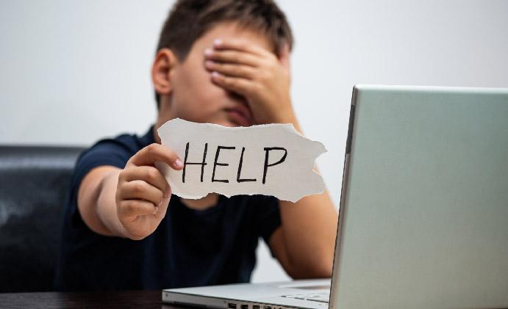
What the victim can do
Don't Respond - It is never easy to avoid it. However, sometimes bullies are encouraged by seeing a reaction.
Reach out - Often times the best thing to do is to come forward in order to make it stop. The best people to reach out to include:
- Friends
- A trusted teacher/ administrator
- Parents
Never give up - All bad things have to come to an end. Keep searching for the right resolution.

Slide 13

What can you do:
Do not join in on the bullying, offer support and stand up for the person being bullied, and encourage them to seek help and support.
Never
­Sink to the bully’s level
Forward bullying content or messages
Believe the bully
It's time to take a stand against cyberbullying. be the change that we all want to see, because it doesn't start with a power button, it starts with you.

Slide 14
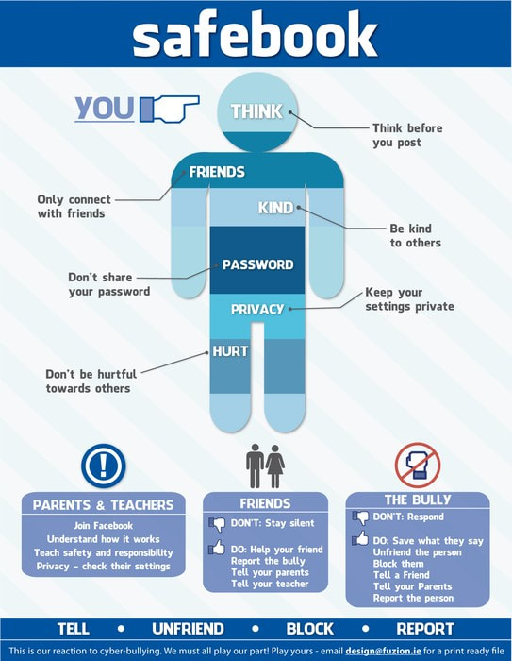
Key advice for teachers and parents
What should you look for?
- Stress/ lack of motivation or energy for school work/ anxiety/ loss of confidence/ lack of appetite/ comfort eating/ aggressive behavior, depression/ problem sleeping/ self harm
Confirm that you are dealing with bullying
Target, Duration, Frequency, Intention

Slide 15
Key advice for teachers and parents
Report cyberbullying
Respond appropriately
Help young people understand the line between funny and cruel
Show your child how to stop the cyber bullying
Let them know that they can come to you for help

Slide 16
When and how to contact service providers
Video /photo sharing sites help link
Youtube.com
Flickr.com
Social networking sites- report abuse
Facebook
Myspace
Nimble

Slide 17
When and how to contact service providers
Internet chat – support/ abuse links
Windows messenger live
Skype
Yahoo Messenger
Mobile phones -blocking/ restrictions/ dual access

Slide 18

It's time to take a stand against cyberbullying. Be the change that we all want to see. It starts with you, not with a power button.

